Slide 1
EC566 – Macroeconomics for Business
Lecture 15 - week 20
Phillips Curve – Relationship between Unemployment and Inflation
L&C – ch.21
B&P – Ch. 15, Ch. 8 (Section 8.2)

Slide 2
Objectives
Phillips curve: relationship between inflation and unemployment
Has it changed over time?
Is there a trade-off between inflation and unemployment?
The role of Macroeconomic Policies and Phillips curve

Slide 3
Unemployment and Inflation:
Is There a Trade-off?
Many people think there is a trade-off between inflation and unemployment
The idea originated in 1958 when A.W. Phillips showed a negative relationship between unemployment and nominal wage growth in Britain during 1861-1913
In the 1950s and 1960s many nations seemed to have a negative relationship between the two variables

Slide 4
Is there a trade-off?
The United States appears to be on one Phillips curve in the 1960s
This suggested that policymakers could choose the combination of unemployment and inflation they most desired
But the relationship fell apart in the following three decades
The 1970s were a particularly bad period, with both high inflation and high unemployment, inconsistent with the Phillips curve

Slide 5
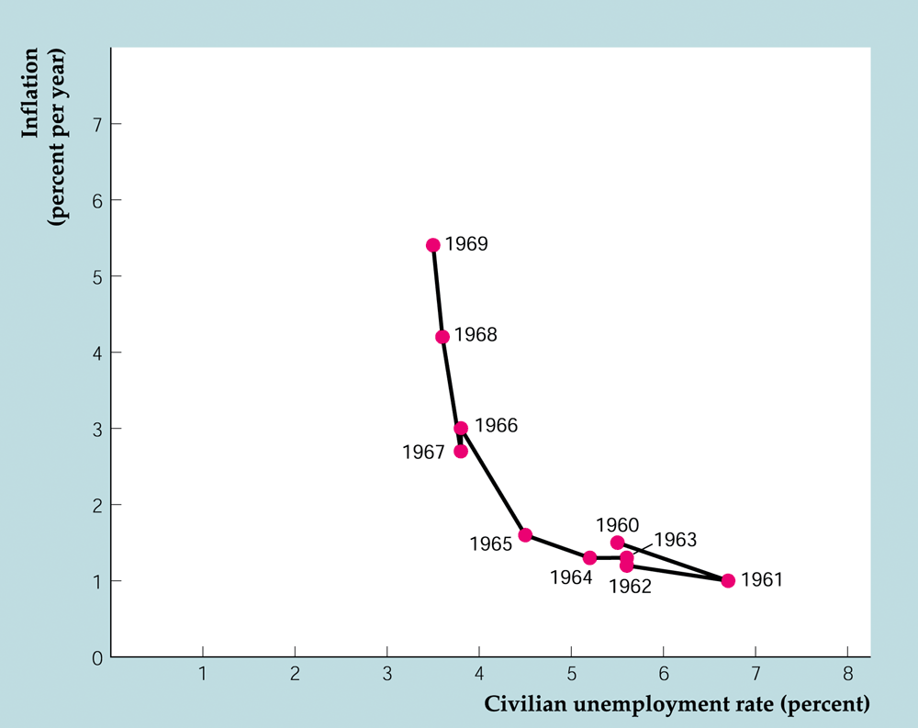
The Phillips curve and the U.S. economy during the 1960s

Slide 6
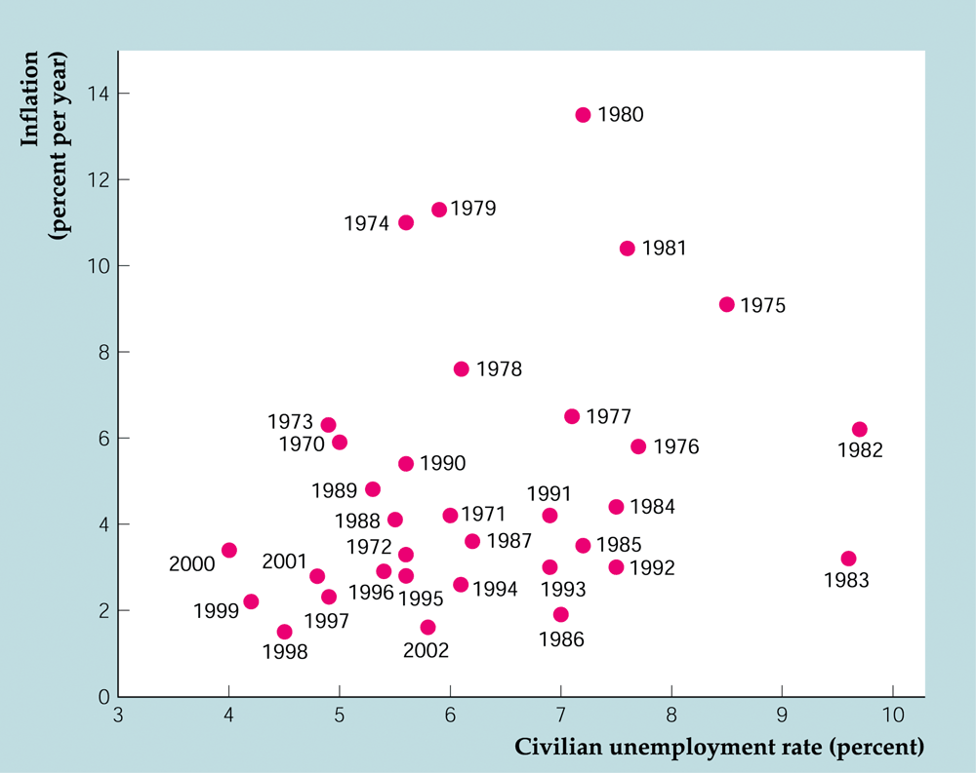
Inflation and unemployment in the United States, 1970–2002

Slide 7
Theoretical foundation of Phillips curve
During 1960s and prior - the validity of empirical relationship between inflation and unemployment explained with theoretical explanation:
excessive demand led to lower unemployment putting upward pressure on wages
Low demand led to higher unemployment caused downward pressure on wage rates
Wages positively associated with demand which is inversely related to unemployment
Negative relation between rate of wage change and unemployment

Slide 8
Cont…
Later transformations–
Nominal wage was changed to real wage (w-p) on the basis that real wage cause changes in real variables
change in wage rates transformed into price level ; as a mark-up on wages that move in step with wages
Hence forth Phillips curve referred as a negative relation between inflation rate and unemployment
Trade-off between two, provided policy makers to choose from a menu of alternative inflation-unemployment combinations

Slide 9
Unemployment and Inflation:
Innovations to original Phillips Curve
The expectations-augmented Phillips curve:
Friedman and Phelps: The cyclical unemployment rate (the difference between actual and natural unemployment rates) depends only on unanticipated inflation (the difference between actual and expected inflation)
This theory was made before the Phillips curve began breaking down in the 1970s
It suggests that the relationship between inflation and the unemployment rate isn’t stable

Slide 10
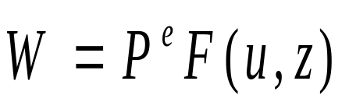

Derivation of Philips Curve
Wage setting equation:
The aggregate nominal wage, W, depends on three factors:
  The expected price level, P^{e}
  The unemployment rate, u
  A catchall variable, z, that stands for all other variables that may affect the outcome of wage setting.

Slide 11
Expected price level
Both workers and firms care about real wages (W/P), not nominal wages (W).
  Workers do not care about how many dollars they receive but about how many goods they can buy with those dollars. They care about W/P.
  Firms do not care about the nominal wages they pay but about the nominal wages, W, they pay relative to the price of the goods they sell, P. They also care about W/P.

Slide 12
The unemployment rate
Also affecting the aggregate wage is the unemployment rate, u.
If we think of wages as being determined by bargaining, then higher unemployment weakens workers’ bargaining power, forcing them to accept lower wages. Higher unemployment allows firms to pay lower wages and still keep workers willing to work.

Slide 13
The other factors
The third variable, z, is a catchall variable that stands for all the factors that affect wages, given the expected price level and the unemployment rate.
Unemployment insurance is the payment of unemployment benefits to workers who lose their jobs.
The higher the workers bargaining power, the higher the wages

Slide 14
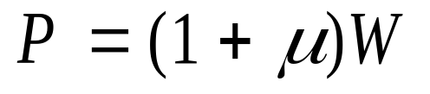
Price determination
Firms set their price according to:
The term μ is the markup of the price over the cost of production. If all markets were perfectly competitive, μ = 0, and P = W.

Slide 15
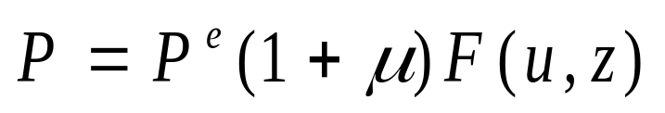
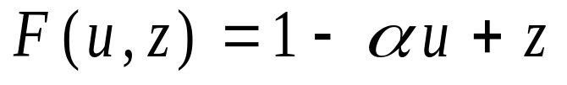
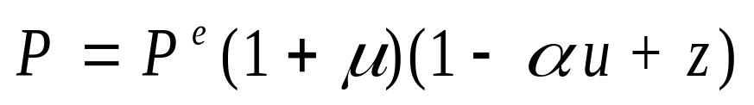
Price setting + wage setting
Putting price setting equation and wage setting equation together
First, the function F, assumes the form:
Then, replace this function in the one above:

Slide 16
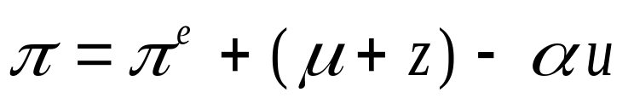
Philips Curve
After some algebra, we go from price level and expected price level to inflation and expected inflation.

Slide 17
Natural rate of unemployment
Unemployment associated with frictions and structural imbalances in the economy (not cyclical unemployment)
Sometimes referred as non-accelerating rate inflation rate of unemployment (NAIRU)
The unemployment rate when inflation is equal to expected inflation.

Slide 18
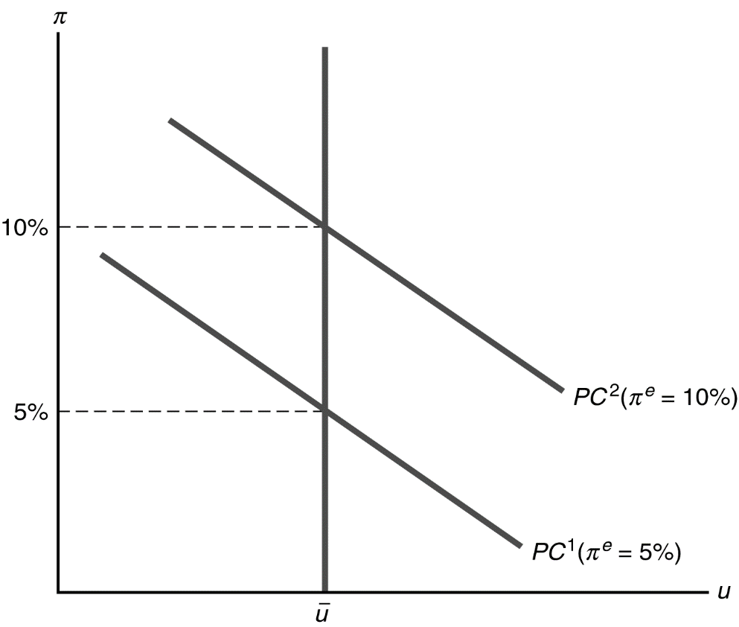
Unemployment and Inflation:
Is There a Trade-off?
The shifting Phillips curve
The Phillips curve shows the relationship between unemployment and inflation for a given expected rate of inflation and natural rate of unemployment
Changes in the expected rate of inflation
For a given expected rate of inflation, the Phillips curve shows the trade-off between cyclical unemployment and actual inflation
b. Higher expected inflation implies a higher Phillips curve

Slide 19
The Shifting Phillips Curve
Why did the original Phillips curve relationship apply to many historical cases?
The original relationship between inflation and unemployment holds up as long as expected inflation and natural rate of unemployment are approximately constant.
This was true in the United States in the 1960s, so the Phillips curve appeared to be stable

Slide 20
Cont…
Why did the U.S. Phillips curve disappear after 1970?
Both the expected inflation rate and the natural rate of unemployment varied considerably more in 1970s than they did in 1960s
Especially important were the oil price shocks of 1973–74 and 1979-80
Also, the composition of the labor force changed in the 1970s and there were other structural changes in the economy as well, raising the natural rate of unemployment
Monetary policy was expansionary in the 1970s, leading to high and volatile inflation

Slide 21
Macroeconomic Poicies and Phillips Curve
Can the Phillips curve be exploited by policymakers?
Can they choose the optimal combination of unemployment and inflation?
Classical model: NO
The unemployment rate returns to its natural level quickly, as people’s expectations adjust
So unemployment can change from its natural level only for a very brief time
Also, people catch on to policy games; they have rational expectations and try to anticipate policy changes, so there is no way to fool people systematically

Slide 22
Macroeconomic Policy and Phillips Curve
Can the Phillips curve be exploited by policymakers?
Can they choose the optimal combination of unemployment and inflation?
Keynesian model: YES, temporarily
The expected rate of inflation in the Phillips curve is the forecast of inflation at the time the oldest sticky prices were set
It takes time for prices and expected prices to adjust, so unemployment may differ from the natural rate for some time

Slide 23
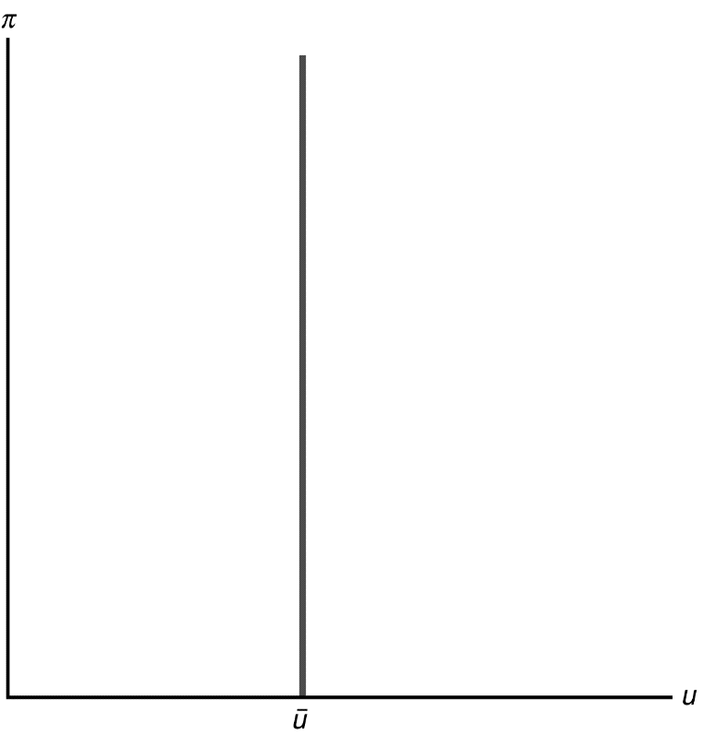
Long-run Phillips curve
Long-run: U = U_{N} for both Keynesians and Classical economists
Long-run Phillips curve is vertical since when:
π^{e} = π,
U = U_{N}

Slide 24
Summary
Today’s lecture covered:
Trade off between inflation and unemployment in the short run and long run
Break-down of the relationship over the time period and its reasons
Role of Macroeconomic policies and the Philipps curve

